Slide 1
Certified Robustness of
Deep Neural Networks
Example slides by DSC 291 SP24 TA
Akshay Kulkarni
04/16/2024

Slide 2
Paper [A]: Interval Bound Propagation for Training Verifiably Robust Models
Paper [B]: Linearity Grafting: Relaxed Neuron Pruning Helps Certifiable Robustness
[A] Gowal et al., “On the Effectiveness of Interval Bound Propagation for Training Verifiably Robust Models”, ICCV 2019
[B] Chen et al., “Linearity Grafting: Relaxed Neuron Pruning Helps Certifiable Robustness”, ICML 2022

Slide 3
Sec 1: Introduction & Motivation

Slide 4
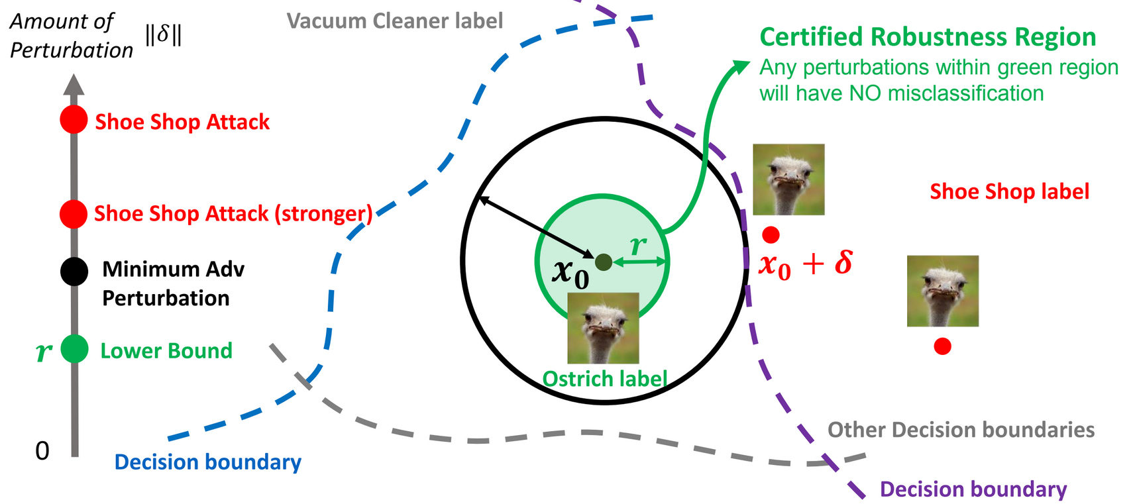
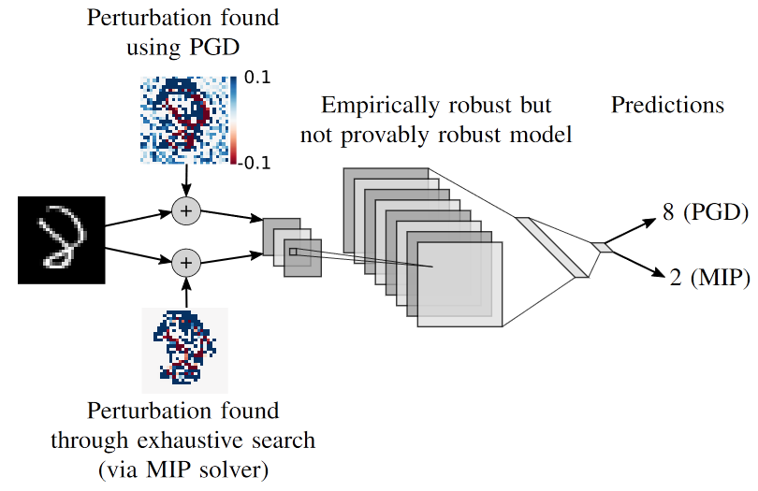
Overview of the field: Certified Robustness
Certified robustness region
A radius around the input in which any perturbation will have NO misclassification
Most empirically robust models (FGSM/PGD-trained) are not certifiably robust
We need specific training strategies to obtain certifiably robust models

Slide 5
What’s the problem that this paper is trying to solve
Paper [A] - Interval Bound Propagation
Developing a fast method for training verifiably robust models
While the ideas behind IBP are studied in prior works^{[1, 2]}
using it directly results in a difficult optimization problem with unstable performance
How to stabilize the performance?
Paper [B] - Linearity Grafting
How to obtain certifiably robust models without expensive certified robustness training?
2k to 3k epochs needed compared to 100-200 in empirically robust training
Similarities: both want to improve the efficiency of certified robustness training
Differences are in the approach of each paper

Slide 6
Why is this problem important
Certified robustness
Existing empirical defenses (like those using FGSM/PGD) cannot find worst-case attacks
Cannot guarantee that brute force enumeration (MIP solvers) won’t break empirical defenses
Hence, we need formal verification
A provable guarantee that an NN is consistent with a specification for all possible inputs
Certified robustness as a prerequisite for deploying DNNs in the real-world
Empirically trained robust models are often found to not be certifiably robust
Existing certified robustness training methods are
Computationally expensive (much longer training than empirical adv. training)
And tend to sacrifice clean accuracy for certified robustness
Notes:
MIP - mixed integer programming

Slide 7
Sec 2: Related works

Slide 8
What are existing approaches to solve this problem
Certified Robustness
Complete verifiers: Mixed-Integer-Linear-Program (MILP)^{[3, 4]}, Branch and Bound (BaB)^{[5, 6]}
MILP-solver based → limited to very small models
BaB → uses an incomplete verifier iteratively as a sub-procedure
Incomplete verifiers:
Rely on duality^{[7, 8]}, linear relaxations^{[9-11]}, or semidefinite relaxations^{[12, 13]} for fast verification
Method | Pros | Cons
Complete Verifiers ^{[3-6]} | Tighter bounds of certified robustness | Expensive; cannot scale to practically used model arch.
Incomplete Verifiers^{[7-13]} | Fast, can be used in training^{[14, 15]} | Weaker bounds

Slide 9
What are existing approaches to solve this problem
Pruning (used in Paper [B])
Compression by eliminating redundancy in over-parameterized NNs
Unstructured pruning^{[14]}: zero out insignificant parameters based on some heuristics
Structured pruning^{[15]}: discard sub-structures (eg. layers or channels) based on heuristics
Pruning for Robustness
HYDRA^{[16]}: Prune a network using robustness objectives to preserve robustness
Stochastic Activation Pruning (SAP)^{[17]}: Randomly drop less-activating neurons
Method | Pros | Cons
HYDRA^{[16]} | Works for non-robust, empirically and certifiably robust models | Expensive since already trained model has to be retrained with pruning and robustness objectives
SAP^{[17]} | Simple and efficient | Only empirical defense

Slide 10
Sec 3: Main methods

Slide 11
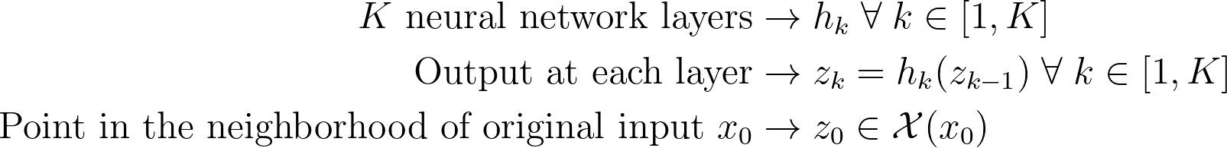

Key ideas of this paper (Paper [A] - IBP)
Preliminaries
Specification of certified robustness
The network output should not change for all inputs around the original input
Mathematically,
The vector c and scalar d are related to the true label and the original input
Intuitively, considering this as a binary classifier boundary, the decision should not change

Slide 12
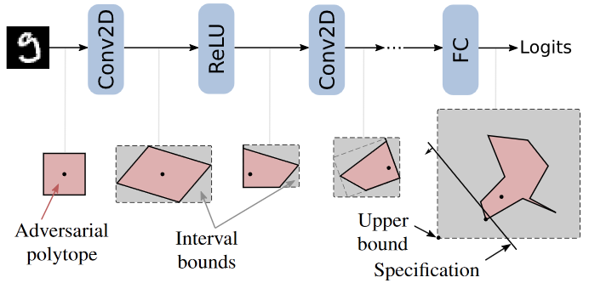
Key ideas of this paper (Paper [A] - IBP)
Verification specification
Model output should not change for a set of inputs around some point
Interval bound propagation (IBP)
IBP aims to find an upper bound on the above specification
If upper bound is negative ⇒ model is certifably robust for that sample
This is because upper bound is the highest possible value
How to find the upper bound? → bound the activations at each layer
Use closed form solutions for the bounds of neurons at each layer using the bounds of prev. layer
Bound at input is the allowable perturbation 𝜖

Slide 13
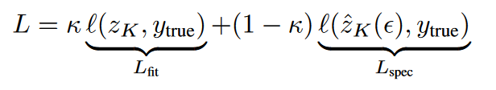
Key ideas of this paper (Paper [A] - IBP)
Training certifiably robust models with IBP
Novelty: specification loss → CE loss b/w worst-case logits and true class
Worst-case logits obtained using the propagated bounds
True class gets lower bound value, all other classes get upper bound value
In the worst case, all classes other than true class have maximum activations (upper bound)
Why this loss? Minimizes upper bound and maximizes lower bound (tighter bounds)
Overall loss → convex combination of usual data fitting loss (CE loss) and specification loss
Training procedure
Start with K=1 and decay it to 0.5 for a good balance between satisfying specification & fitting data
Start with 𝜖=0 and gradually increase to actual perturbation radius

Slide 14
Key ideas of this paper (Paper [B] - Linearity Grafting)
High-level ideas
Non-linearity causes difficulty in certifying the robustness (also shown in prev. works)
Linearity is desirable, and sparsity is a special case of linearity
Proposed method (high-level)
Input: Adversarially pretrained robust model, corresponding labeled dataset (like CIFAR10)
Linearize unstable and insignificant neurons
First, rank neurons based on stability and significance
Replace ReLU w/ linear activation (but with trainable affine parameters)
Finetune entire model to restore performance
Result: Model with improved verified accuracy (but with drop in standard and robust acc.)
Novelty
Efficiently training a verifiably robust model w/o a certifiable loss (expensive) at training time

Slide 15

Key ideas of this paper (Paper [B] - Linearity Grafting)
Unstable neurons
Mainly focusing on non-linear ReLU activations
If the input to ReLU is always negative or always positive → stable neuron
Formally, lower bound of input should be positive or upper bound should be negative
If input to ReLU is sometimes negative, sometimes positive → unstable neuron
Formally, lower bound of input is negative and upper bound is positive
Rank all neurons by no. of images for which it is unstable, normalized rank is instability score
Insignificant neurons
Rank neurons by activation magnitude, or gradient magnitude, or learned importance scores
Unstable and insignificant neurons →
is the instability score, is the significance score

Slide 16
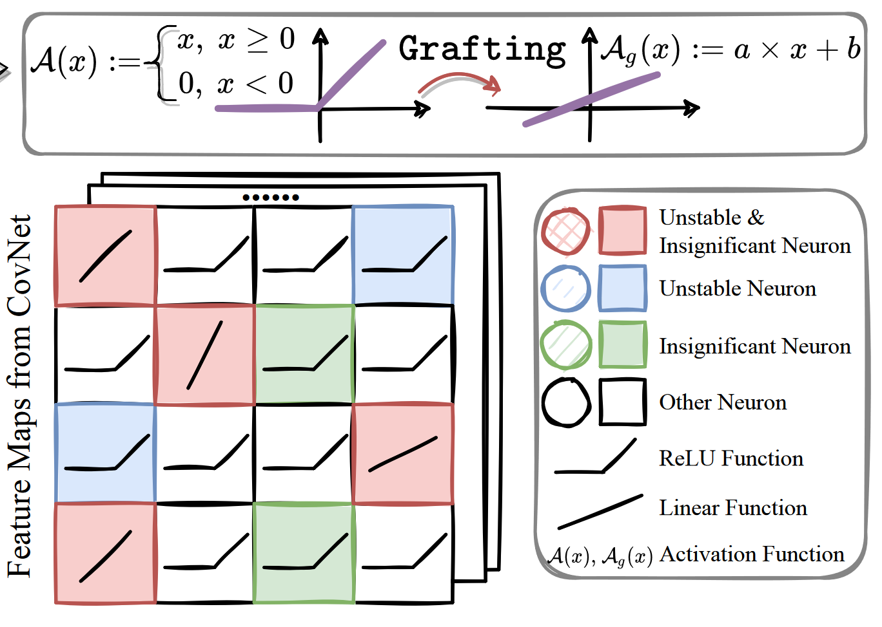
Key ideas of this paper (Paper [B] - Linearity Grafting)
Linearize and finetune grafted activations
Only unstable and insignificant neurons get a linear activation function instead of ReLU
Finetune new parameters a, b for 100 epochs with lower LR (0.01 instead of original 0.1)
Objective is same as Fast Adv. Training^{[19]} (which was the pretrained initialization)
In some experiments, all other weights are also finetuned (LR even lower at 0.001)

Slide 17
Sec 4: Experiment

Slide 18
Experimental setup
What are the datasets/benchmarks?
MNIST
50k training images, 10k test images
10 digit classes (0 to 9)
CIFAR10
50k training images, 10k test images
10 object classes (e.g. airplane, automobile, bird, cat, etc.)
SVHN (Street View House Numbers)
~73k training images, ~26k test images
10 digit classes (0 to 9)
Difference w.r.t. MNIST → color images and each image may contain multiple digits

Slide 19
Experimental setup
What are the baselines methods that this paper compared with?
Paper [A]
Dvijotham et al. [2] → Trains a verifier n/w to predict bounds, concurrent to verification training
Wong et al. [20] → Estimate upper bound via the dual problem of the verification LP
Xiao et al. [21] → Regularizer to reduce the number of ambiguous ReLU neurons
Paper [B]
Baseline (FAT^{[19]}) → R-FGSM based adversarial training (no certified training)
Stochastic Activation Pruning^{[17]} → Prunes activations with the least magnitude
Gradient-based Activation Pruning^{[22]} → Activation gradients used as heuristic for pruning
HYDRA^{[16]} → Learns sparse activation maps
Random grafting → randomly selecting neurons instead of using the proposed metrics

Slide 20
Experimental setup
What are the evaluation metrics?
Standard accuracy → Accuracy on original (unmodified) data
Robust accuracy → Empirical robustness measure (computed using PGD100 attacked samples)
Verified accuracy
Paper [A] uses a solver for the MIP formulation^{[3]}
Paper [B] uses 𝛼,𝛽-CROWN^{[18]} (recent SOTA verifier)
The most important metric is verified accuracy (which indicates the success of the method)
Standard accuracy is also important since most inputs in practice will be standard samples

Slide 21
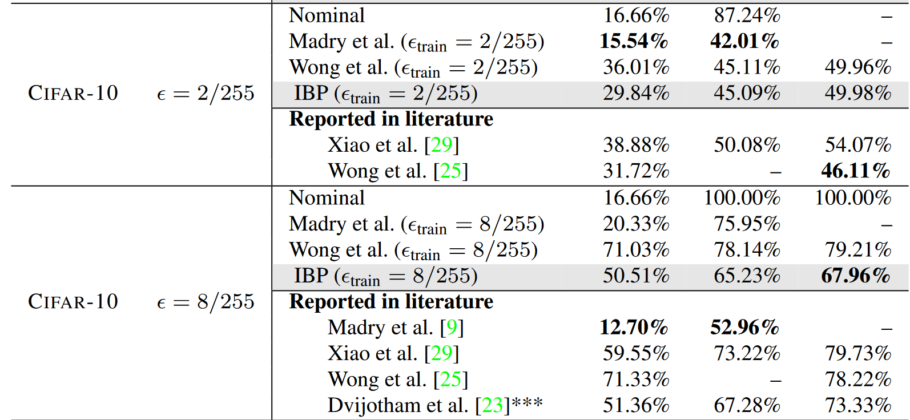
Key results of this paper (Paper [A] - IBP)
Benchmark results (CIFAR10)
Improved verified error and PGD error
Drop in standard test error (tradeoff)

Slide 22
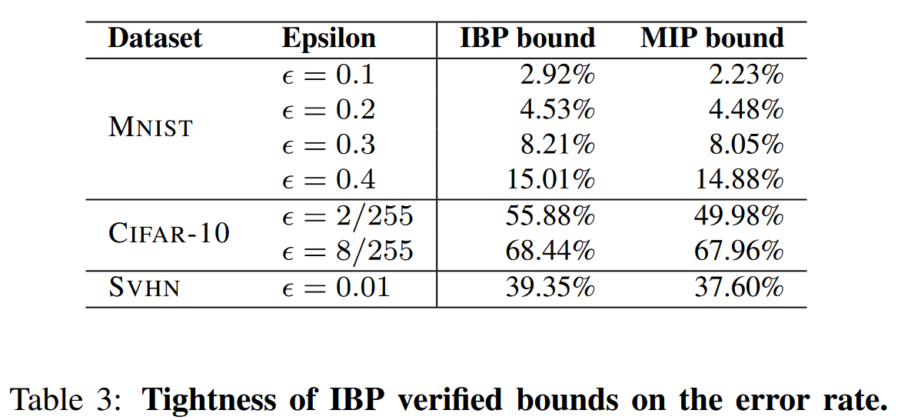
Key results of this paper (Paper [A] - IBP)
Tightness of IBP verified bounds
Bounds are looser at lower epsilon but close to the MIP bounds

Slide 23
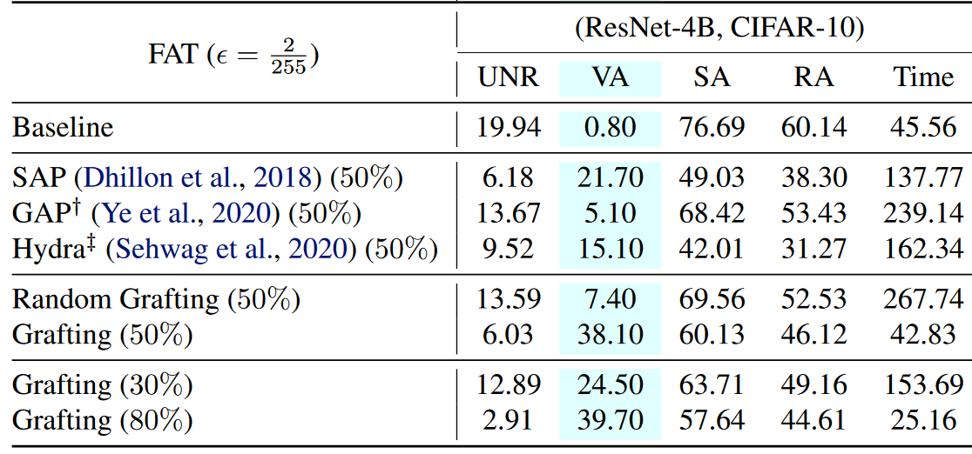
Key results of this paper (Paper [B] - Linearity Grafting)
Evaluation of certified robustness with 𝛼,𝛽-CROWN^{[18]} (SOTA complete verifier)
They reduce no. of unstable neurons (UNR)
Correlated with improvement in certified robustness or verified accuracy (VA)
Empirical robustness (RA) & standard acc. (SA) drops w.r.t. baseline but better than prior arts

Slide 24
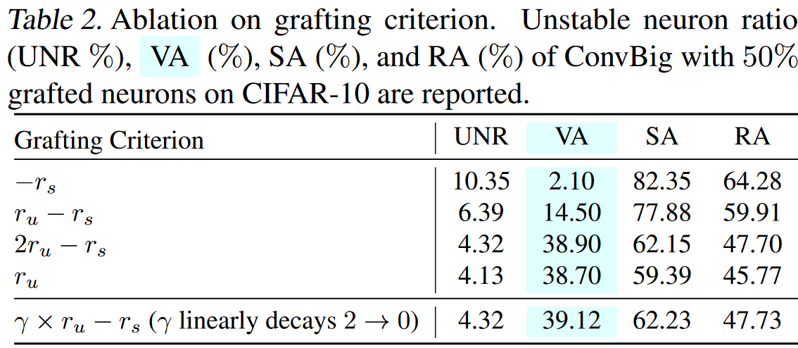
Key results of this paper (Paper [B] - Linearity Grafting)
Ablation on selection criteria
Only significance criteria most preserves empirical robustness (RA) & standard acc. (SA)
But RA, SA drops slightly w.r.t. baseline
Only unstable criteria is good enough for VA but combination improves standard acc. (SA)

Slide 25
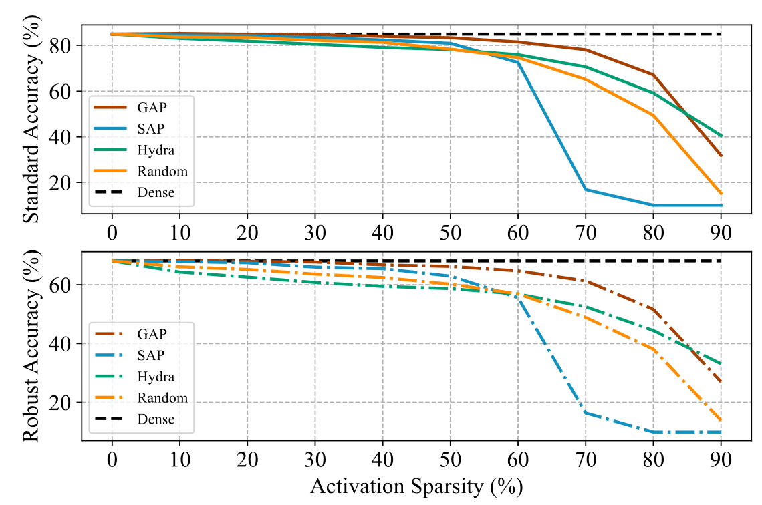
Key results of this paper (Paper [B] - Linearity Grafting)
Ablation on significance measures
GAP performs the best (except at 90% sparsity where learned scores of HYDRA are better)
Interestingly, random pruning is better than activation based pruning at higher sparsities

Slide 26
Code reproduction (BONUS) - Paper [B]
Setup
Started with the official GitHub repository from the authors
Setup python environment as per their instructions (fairly straightforward, no issues)
Reproduced results
Trained baseline and linearity-grafting based CNN-B models with Fast Adversarial Training^{[19]}
Observations
Almost same robust accuracy (PGD-100), higher standard accuracy with grafting
Verified accuracy is significantly lower (takes very long to run, ~12 hrs for 1000 samples)
Verified acc. could be improved if std. acc. reduces (tradeoff) with some tuning
CNN-B on CIFAR10, 𝜖 = 2/255 |  | Std. Acc. | PGD100 | Verified Acc.
Reported | Baseline | 79.95 | 62.23 | 37.40
 | + Linearity Grafting | 74.08 | 58.76 | 50.40
Reproduced | Baseline | 79.63 (-0.32) | 62.36 (+0.13) | 37.30 (-0.10)
 | + Linearity Grafting | 76.39 (+2.31) | 58.73 (-0.03) | 43.30 (-7.10)

Slide 27
Sec 5: Concluding remarks

Slide 28
Summary
Paper [A] - Interval Bound Propagation
A simple bounding technique for training large verifiable models
Strong results on MNIST, CIFAR10, SVHN, and downscaled-ImageNet
Positioned as a useful baseline for future works on certified defense
Paper [B] - Linearity Grafting
A new relaxed neuron pruning paradigm for improved & scalable certified robustness
Takeaways:
Grafting insignificant/unstable neurons reduces non-linearity & tightens verification bounds
Parameters in grafted neurons help generalization performance
Achieve competitive certified robustness without certified robust training
Scales up verification to large adversarially-trained models

Slide 29
Sec 6: Discussion

Slide 30
Limitations of this paper (Paper [A] - IBP)
Empirical limitations
Compares only on small datasets (since it is an old paper)
Training needs tricks for stabilization (needs more hyperparameter tuning)
Conceptual limitations
They derive closed form solutions for the bounds for every type of layer and activation
May become tedious (or impossible) when dealing with new layers or new architectures

Slide 31
Limitations of this paper (Paper [B] - Linearity Grafting)
Empirical limitations
Significant drop in standard accuracy and empirical robustness
Compute-heavy, requires 100 epochs of adv. training (apart from 200 epochs of initialization)
Theoretical aspects
No theoretical bounds, empirically computed the bounds and claim tighter bounds

Slide 32
What are some possible future directions
How to scale verification for practical sized models?
Even SOTA verifiers^{[18]} fail for models like ResNet18 with too many unstable ReLU neurons
A related direction is to develop verification-friendly architectures and activations
Theoretical verification bounds based on pruning
Can we improve certified robustness without training?
Improving over Paper [B] that requires training but gets rid of robustness objectives

Slide 33
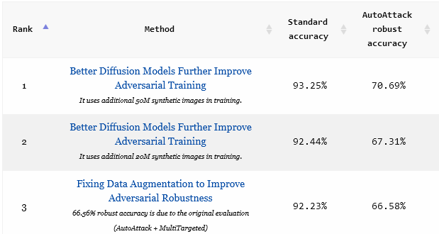
Discussion
Q1: Why do most robustness works focus on image classification?
There is a large gap between robust accuracy and standard accuracy (~20% gap in SOTA)
Hence, the problem is not yet “solved” even for the simple image classification setting
However, there is interest in exploring robustness in other tasks (e.g. papers under topic-R9)
Adversarial Robustness with Non-uniform Perturbations (NeurIPS21)
On Adversarial Robustness of Trajectory Prediction for Autonomous Vehicles (CVPR22)

Slide 34
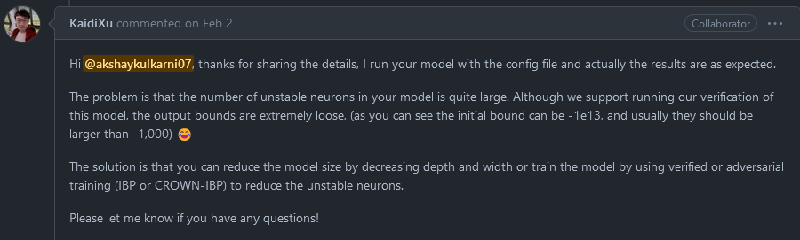
Discussion
Q2: Can we compute the verified accuracy for any neural network?
Theoretically yes, but in practice, it is infeasible to compute the bounds for larger networks
Recent SOTA verification methods^{[18]} rely on reduced number of unstable ReLU neurons
These fail to verify a model if there are too many unstable neurons

Slide 35
References
[1] Mirman, Geher, and Vechev, “Differentiable abstract interpretation for provably robust neural networks”, ICML18
[2] Dvijotham et al., “Training Verified Learners with Learned Verifiers”, arXiv:1805.10265
[3] Tjeng, Xiao, and Tedrake, “Evaluating Robustness of Neural Networks with Mixed Integer Programming”, ICLR19
[4] Dutta, Jha, Sankaranarayanan, and Tiwari, “Output Range Analysis for Deep Feedforward Neural Networks”, NFM18
[5] Bunel et al., “A Unified View of Piecewise Linear Neural Network Verification”, NeurIPS18
[6] Wang et al., “Formal Security Analysis of Neural Networks using Symbolic Intervals”, USENIX Security 2018
[7] Dvijotham et al., “A dual approach to scalable verification of deep networks”, UAI18
[8] Wong and Kolter, “Provable defenses against adversarial examples via the convex outer adversarial polytope”, ICML18
[9] Wang et al., “Efficient Formal Safety Analysis of Neural Networks”, NeurIPS18
[10] Zhang et al., “Efficient Neural Network Robustness Certification with General Activation Functions”, NeurIPS18
[11] Salman et al., “A Convex Relaxation Barrier to Tight Robustness Verification of Neural Networks”, NeurIPS19

Slide 36
References
[12] Raghunathan, Steinhardt, and Liang, “Semidefinite relaxations for certifying robustness to adversarial examples”, NeurIPS18
[13] Dathathri et al., “Enabling certification of verification-agnostic networks via memory-efficient semidefinite programming”, NeurIPS20
[14] Han et al., “Deep Compression: Compressing Deep NNs with Pruning, Trained Quantization and Huffman Coding”, ICLR16
[15] Liu et al., “Learning efficient convolutional networks through network slimming”, ICCV17
[16] Sehwag et al., “HYDRA: Pruning Adversarially Robust Neural Networks”, NeurIPS20
[17] Dhillon et al., “Stochastic Activation Pruning for Robust Adversarial Defense”, ICLR18
[18] Zhang et al., “A Branch and Bound Framework for Stronger Adversarial Attacks of ReLU Networks”, ICML22
[19] Wong, Rice, and Kolter, “Fast is better than free: Revisiting adversarial training”, ICLR20
[20] Wong, Schmidt, Metzen, and Kolter, “Scaling provable adversarial defenses”, NeurIPS18
[21] Xiao et al., “Training for Faster Adversarial Robustness Verification via Inducing ReLU Stability”, ICLR19
[22] Ye et al., “Accelerating CNN Training by Pruning Activation Gradients”, ECCV20

